Slide 1
MICROWAVE COMMUNICATION
“God chose the weak things of the world to shame the strong.”
1 Cor. 1:27

Slide 2
What is Microwave
Microwave Communications
Is simply a high radio frequency link specifically designed to provide signal connection between two specific points.
Also coined as Line-of-Sight or LOS communications, Radio Link, Point-to-Point communications.

Slide 3
What is Microwave Communication
A communication system that utilizes the radio frequency band spanning 2 to 60 GHz. As per IEEE, electromagnetic waves between 30 and 300 GHz are called millimeter waves (MMW) instead of microwaves as their wavelengths are about 1 to 10mm.
Small capacity systems generally employ the frequencies less than 3 GHz while medium and large capacity systems utilize frequencies ranging from 3 to 15 GHz. Frequencies > 15 GHz are essentially used for short-haul transmission.
3

Slide 4
Classification of Microwave
Nature
Analog
Digital
Distance / Frequency
Short Haul
used for short distance microwave transmission usually at lower capacity ranging from 64 kbps up to 2Mbps
Medium Haul
Long Haul
used for long distance/multi-hop microwave transmission. Used for backbone route applications at 34 Mbps to 620 Mbps capacity
Capacity / Bandwidth
Light (Narrow Band)
Medium (Narrow Band)
Large (Wide Band)

Slide 5
Advantages of Microwave System
The gain of an antenna is proportional to its electrical size.
A 1% bandwidth provides more frequency range at microwave frequencies than that of HF.
Microwave signals travel predominantly by LOS.
There is much less background noise at microwave frequencies than at RF.
Microwave systems do not require a right-of-way acquisition between stations.
Fewer repeaters are necessary for amplification.
Underground facilities are minimized.
Increased reliability and less maintenance.

Slide 6
Disadvantage of Microwave System
More difficult to analyze electronic circuits
Conventional components (resistors, inductors, and capacitors) cannot be used at microwave frequencies.
There are physical limitations in creating resonant circuits at microwave frequencies.
Conventional semi-conductor devices do not work properly at microwave frequencies because of
Inherent inductances and capacitances of the terminal leads and
Transit time
For amplification, vacuum tubes are used such as klystrons, magnetrons and traveling wave tubes (TWT).
Distance of operation is limited by line of sight (LOS).
Microwave signals are easily reflected and/or diverted because of the very short wavelength.
Atmospheric conditions such as rain/fog can attenuate and absorb the microwave signal especially at 20 GHz and up.

Slide 7
Terrestrial Microwave
Types Of Microwave Stations
Terminals – are points in the system where the baseband signals either originate or terminate
Repeaters – are points in the system where the baseband signals maybe reconfigured or simply repeated or amplified.
Passive Microwave repeaters – a device that re-radiates microwave energy without additional electronic power.
back to back
billboard type
Active Microwave repeater – a receiver and a transmitter placed back to back or in tandem with the system. It receives the signal, amplifies and reshapes it, then retransmits the signal to the next station.

Slide 8
The K-Curve
A numerical figure that considers the non-ideal condition of the atmosphere refraction that causes the ray beam to be bent toward the earth or away from the earth.
where:
r_{o} = 6370 km

Slide 9
K-Curve Conditions
Sub-standard Condition
The microwave beam is bent away from the Earth
Standard Condition
The fictitious earth radius appears to the microwave beams to be longer than the true earth radius.
Super-standard Condition.
This condition results in an effective flattening of the equivalent earth’s curvature.
Infinity Condition (Flat Earth Condition)
This condition results to zero curvature (as if the earth is flat) and the microwave beam follows the curvature of the earth.

Slide 10
Effective Earth Radius
where:
r_{e} = effective earth radius
r_{o} = true earth radius (6370 km)
N_{S} = Surface Refractivity (300)
where:
N_{S} = Surface Refractivity (300)
N_{O} = Mean Sea Level Refractivity
H_{S} = Elevation of Link Above Sea Level

Slide 11
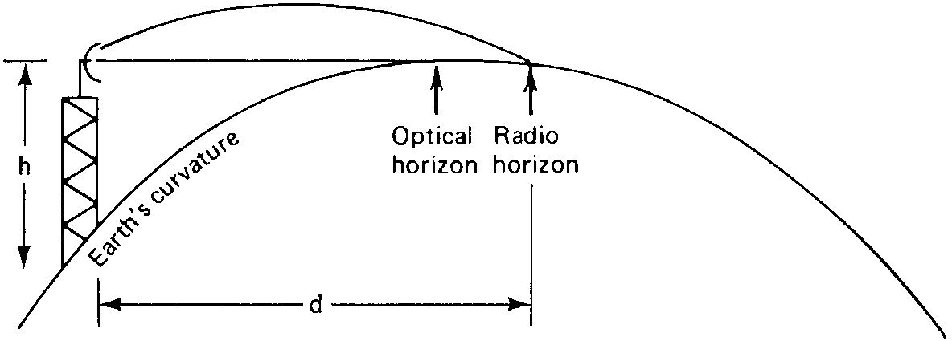
Earth Bulge and Curvature
The number of feet or meters an obstacle is raised higher in elevation (into the path) owing to earth curvature or earth bulge.
d₁
d₂
where:
h = distance in feet from horizontal reference line
d₁ = distance in statute miles from one end
d₂ = distance from the other end of the path
where:
h = distance in meters from horizontal reference line
d₁ = distance in kilometers from one end
d₂ = distance from the other end of the path

Slide 12
Duplex Transmission
RX = 17.880
TX = 19.440
High Band Transmitter
Low Band Transmitter
TX = 17.880
RX = 19.440

Slide 13
Frequency Planning
Frequency | Path Length
23 GHz | 10 miles
18 GHz | 15 miles
10.5 GHz | 25 miles
8 GHz | 30 miles
8 GHz
10.5 GHz
18 GHz
23 GHz
25 mi
30 mi
15 mi
10 mi

Slide 14
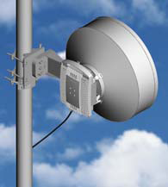
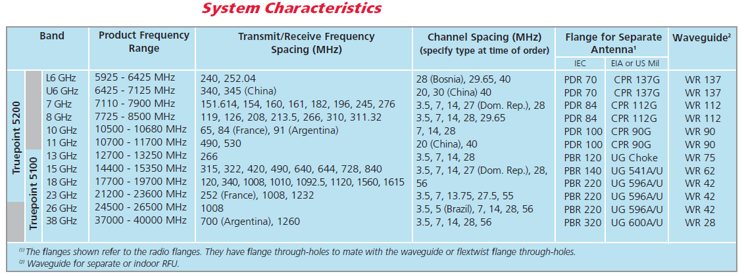
Data Sheets
Frequency of Operation
12700 – 13250 MHz

Slide 15
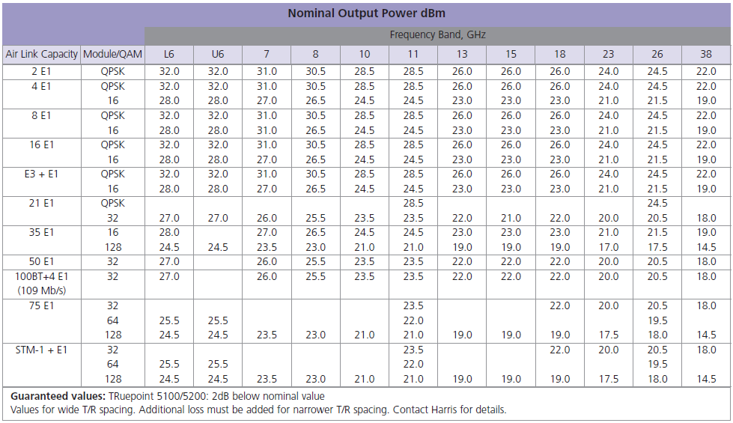
Nominal Output Power

Slide 16
Fresnel Zone
Fresnel Zone - Areas of constructive and destructive interference created when electromagnetic wave propagation in free space is reflected (multipath) or diffracted as the wave intersects obstacles. Fresnel zones are specified employing ordinal numbers that correspond to the number of half wavelength multiples that represent the difference in radio wave propagation path from the direct path
The Fresnel Zone must be clear of all obstructions.

Slide 17
Fresnel Zone
Typically the first Fresnel zone (N=1) is used to determine obstruction loss
The direct path between the transmitter and the receiver needs a clearance above ground of at least 60% of the radius of the first Fresnel zone to achieve free space propagation conditions
Earth-radius factor k compensates the refraction in the atmosphere
Clearance is described as any criterion to ensure sufficient antenna heights so that, in the worst case of refraction (for which k is minimum) the receiver antenna is not placed in the diffraction region

Slide 18
Fresnel Zone
1st Fresnel Zone
Line-of-Sight
0.6 of 1st Fresnel Zone
where:
F₁ = radius of the first Fresnel zone in feet
d₁ = distance in statute miles from one end
d₂ = distance from the other end of the path
D = total distance in statute miles
where:
F₁ = radius of the first Fresnel zone in meters
d₁ = distance in kilometers from one end
d₂ = distance from the other end of the path
D = total distance in kilometers

Slide 19
Line-of-Sight Considerations
Clearance criteria to be satisfied under normal propagation conditions
- Clearance of 60% or greater at the minimum k suggested for the certain path
- Clearance of 100% or greater at k=4/3
- In case of space diversity, the antenna can have a 60% clearance at k=4/3 plus allowance for tree growth, buildings (usually 3 meter)

Slide 20
Line-of-Sight Considerations
Microwave Link Design is a methodical, systematic and sometimes lengthy process that includes
Loss/attenuation Calculations
Fading and fade margins calculations
Frequency planning and interference calculations
Quality and availability calculations

Slide 21
Antenna Gain
where:
η = Aperture Efficiency(between 0.5 and 0.8)
D = Antenna Diameter in meters
λ = Wavelength
where:
η = Aperture Efficiency(between 0.5 and 0.8)
D = Antenna Diameter in meters
f = frequency in GHz

Slide 22
Antenna Architecture
2 GHz
5 GHz
10.5 GHz
25 GHz
3.7m
1.2 m
0.6 m
0.3 m
FIXED GAIN APPROX. 35 dB

Slide 23
Link Analysis Formulas
Microwave Communication

Slide 24
1. Effective Isotropically Radiated Power (EIRP)
the amount of power that would have to be emitted by an isotropic antenna to produce the peak power density observed in the direction of maximum antenna gain.
EIRP = P_{t} + G_{ant} – TLL
where:
P_{t} = RF power output (dBm)
G_{ant} = transmit antenna gain (dB)
TLL = total transmission line loss at transmitter (taken from specs, in dB)

Slide 25
2. Antenna Gain Formula
G_{ant} = η (πd/λ)²
where:
η = antenna efficiency
(typical value = 0.55)
d = diameter of antenna in meters

Slide 26
Antenna Gain Formula
G_{ant} = 20 log f _{(GHz)} + 20 log d _{(m)} + 17.8
where:
f = frequency in GHz
d = diameter of antenna in meters
* The gain of an antenna increases or decreases proportional to the square of its diameter. (If its diameter changes by a factor of 2, its gain changes by a factor of 4 = 6 dB)

Slide 27
3. Isotropic Receive Level (IRL)
IRL = EIRP – FSL
where:
EIRP = Effective Isotropically Radiated Power in dBm
FSL = free space loss in dB

Slide 28
4. Free Space Loss (FSL)
⎧ 4πD ⎫²
⎩ λ ⎭
⎧ 4πfD ⎫²
⎩ C ⎭
FSL = =
FSL = 10 log
FSL = 20 log
⎧ 4πfD ⎫²
⎩ C ⎭
4πfD
C

Slide 29
Free Space Loss (FSL)
FSL = 20 log (4π/C) + 20 log f + 20 log D
When the frequency is given in MHz and distance in km,
FSL = 32.4 + 20 log f _{(MHz)} + 20 log D _{(km)}
When the frequency is given in MHz and distance in miles,
FSL =36.6 + 20 log f _{(MHz)} + 20 log D _{(mi)}

Slide 30
Free Space Loss (FSL)
When the frequency is given in GHz and distance in km,
FSL = 92.4 + 20 log f _{(GHz)} + 20 log D _{(km)}
When the frequency is given in GHz and distance in miles,
FSL = 96.6 + 20 log f _{(GHz)} + 20 log D _{(mi)}

Slide 31
5. Received Signal Level (RSL) – unfaded
RSL = IRL + G_{ant} – TLL
RSL = P_{t} + G_{ant(Tx)} – TLL_{(Tx)} – FSL + G_{ant(Rx)} – TLL_{(Rx)}
where:
IRL = in dBm
G_{ant(Rx)} = receive antenna gain (dB)
TLL_{(Rx)} = transmission line loss at receiver

Slide 32
6. Receiver Threshold (C/N)
the minimum wideband carrier power (C_{min}) at the input to a receiver that will provide a usable baseband output; sometimes called receiver sensitivity
C/N_{(dB)} = RSL_{(dBm)} - Pn_{(dBm)}
where:
Pn = thermal noise threshold of the receiving system

Slide 33
7. Thermal Noise Threshold (Pn)
Pn_{(db)} = 174 + 10 log B + NF
where:
NF = receiver noise figure
B = Bandwidth (hertz)

Slide 34
8. Fade Margin (FM)
equation considers the non-ideal and less predictable characteristics of radio wave propagation such as multi-path loss and terrain sensitivity
Using Barnett-Vignant Equation:
FM = RSL – Receiver Threshold Power Level
FM = 30 log D + 10 log (6ABf) – 10 log (1 –R) – 70
where:
30 log D = multi-path effect
10 log (6ABf) = terrain sensitivity
10 log (1 –R) = reliability objectiveness

Slide 35
Barnett-Vignant Equation
where:
FM - Fade Margin
D - Distance (km)
f - Frequency (GHz)
R - Reliability
(1 – R) – Reliability objective
A – roughness factor
B – factor to convert a worst month probability to an annual probability
A Values
4 smooth terrain, over water, or flat desert
1 average terrain
0.25 mountains, very rough or very dry terrain
B Values
0.5 hot humid areas
0.25 average inland areas, normal, interior temperature or sub-arctic areas
0.125 mountainous or very dry but non-reflective areas

Slide 36
System Gain
- It is the difference between the nominal output power of a transmitter and the minimum input power required by a receiver.
- It must be greater than or equal to the sum of all gains and losses incurred by a signal as it propagates from a transmitter to a receiver.
- It represents the net loss of a radio system.
G_{S} = P_{t} - C_{min}
P_{t} - C_{min} > Losses – Gains
where:
G_{S} – System Gain (dB)
P_{t} – transmitter output power (dBm)
C_{min} – minimum receiver input power for a given quality objective (dBm)

Slide 37
G_{S} = FM + FSL + L_{f} + L_{b} – A_{t} - A_{r}
Gains
A_{t} – transmit antenna gain (dB)
A_{r} – receive antenna gain (dB)
Losses
FSL – free space path loss between antennas
L_{f} – waveguide feeder loss between distribution network and antenna
L_{b} – branching and coupling losses
FM – Fade Margin for a given reliability objective

Slide 38
Sample Problems
1. For a carrier frequency of 6 GHz and a distance of 50 km, determine the free-space path loss.
(Ans: FSL = 142 dB)

Slide 39
Solution:
Given: f = 6 GHz
D = 50 km
Req’d: FSL
Sol’n:
FSL = 20 log
= 20 log
FSL = 142 dB
4πfD
C
4π(6 x 10⁹)(50 x 10³)
3 x 10⁸

Slide 40
2. An FM LOS microwave link operates at 6.15 GHz. The transmitter output power is 1 watt. The path length is 34 km; the antennas at each end have a 35-dB gain and the transmission line losses at each end are 3 dB. Find the received signal level (RSL).
(Ans: RSL = -44.85 dBm)

Slide 41
Solution: Part 1
Given: f = 6.150 GHz
P_{t} = 1 watt = 30 dBm
D = 34 km
G_{ant(Tx)} = G_{ant(Rx)} = 35 dB
TLL_{(Tx)} = TLL_{(Rx)} = 3 dB
Req’d: RSL
Sol’n:
RSL = P_{t} + G_{ant(Tx)} – TLL_{(Tx)} – FSL + G_{ant(Rx)} – TLL_{(Rx)}

Slide 42
Solution: Part 2
Solving for FSL:
FSL = 20 log
= 20 log
FSL = 138. 85 dB
RSL = 30 dBm + 35 dB – 3 dB – 138.85 dB + 35 dB – 3 dB
RSL = - 44.84 dBm
4πfD
C
4π(6.15 x 10⁹)(34 x 10³)
3 x 10⁸

Slide 43
3. Consider a space-diversity microwave radio system operating at an RF carrier frequency of 1.8 GHz. Each station has a 2.4-meter diameter parabolic antenna that is fed by a 100m of air-filled coaxial cable. The terrain is smooth and the area has a humid climate. The distance between stations is 40 km. A reliability objective of 99.99% is desired. Determine the system gain. The air-filled coaxial cable has a feeder loss of 5.4 dB/100m and branching loss of 2 dB.
(Ans: G_{S} = 114.75 dB)

Slide 44
Solution: Part 1:
Given: f = 1.8 GHz
d = 2.4 m (antenna diameter)
D = 40 km
R = 99.99%
L_{f} = 5.4 dB/100m (each station)
L_{b} = 2 dB (each station)
Req’d: G_{S}
Sol’n:
G_{S} = P_{t} – C_{min}
G_{S} = FM + FSL + Lf + Lb – At - Ar

Slide 45
Solution: Part 2
a) FM = 30 log D + 10 log (6ABf) – 10 log (1 –R) – 70
A = 4
B = 0.5
R = 0.9999
FM = 31.4 dB
b) FSL = 20 log
FSL = 129.55 dB
4πfD
C

Slide 46
Solution: Part 3
c) L_{f} = 5.4 dB x 2
L_{f} = 10.8 dB
d) L_{b} = 2 dB x 2
L_{b} = 4 dB
e) A_{t} = A_{r} = 20 log f _{(GHz)} + 20 log d _{(m)} + 17.8
A_{t} = A_{r} = 30.5 dB

Slide 47
Solution: Part 4
G_{S} = FM + FSL + Lf + Lb – At – Ar
= 31.4 dB + 129.55 dB + 10.8 dB
+ 4 dB – 30.5 dB – 30.5 dB
G_{S} = 114.75 dB
* The result indicates that for this system to perform at 99.99% reliability with the given terrain, distribution networks, transmission lines and antennas, the transmitter output power must be at least 114.75 dB more than the minimum receive signal level.

Slide 48
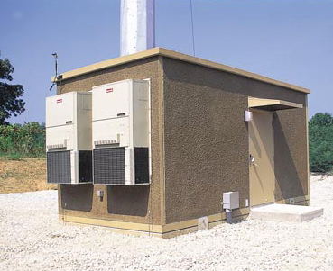
Link Budget
MICROWAVE COMMUNICATION

Slide 49
LINK BUDGET
Is basically the summary of all possible losses and gains that a signal may encounter along a microwave path.
Once the path for a microwave link has been determined, it is necessary to ensure that the received signal power is sufficient for the required signal-to noise ratio.

Slide 50
Transmitter Output Power
taken from the data sheet (specifications) of the microwave radio equipment.
This is the amount of microwave carrier output power, usually expressed in dB_{m}.

Slide 51
Antenna Gain
Tx Antenna Gain
taken from the specifications of the parabolic dish.
The amount of increase in the signal density when it undergoes the process of being focused into a pencil beam.
This amount of gain, usually expressed in dB (over isotropic)
Rx Antenna Gain
taken from the specifications of the parabolic dish.
This amount of gain, usually expressed in dB (over isotropic)
The amount of increase in the signal density when it undergoes the process of being focused back into the waveguide.

Slide 52
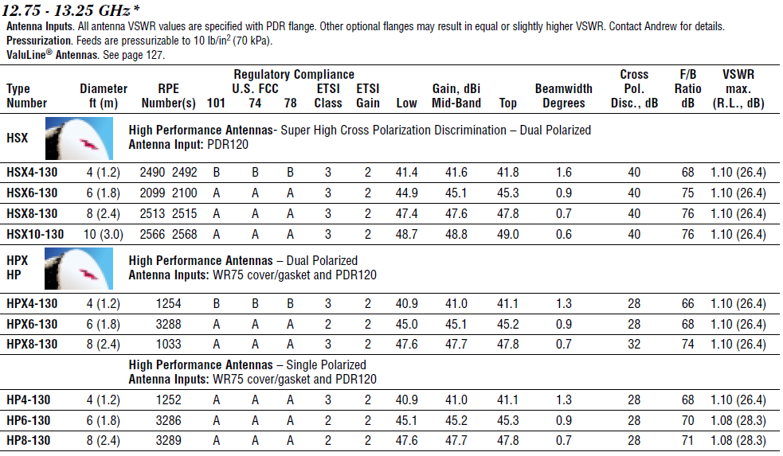
Antenna Gain

Slide 53
Types of Gain
Received Signal Level (RSL)
computed from a formula.
This is the amount of input signal into the receiver from the waveguide.
It is the sum of all losses and gains on the transmitter output.
Receiver Threshold Power
taken from specs of radio equipment.
This is the minimum amount of microwave carrier input power, usually expressed in dBm which the receiver can still accurately detect and discriminate information carried. (C/N)

Slide 54
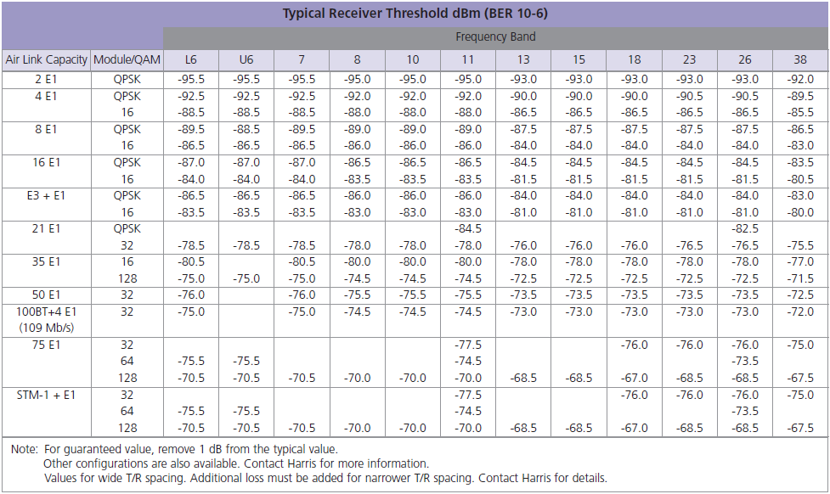
Receiver Threshold Power

Slide 55
Types of Losses
Link Budget Analysis

Slide 56
TYPES OF LOSSES
Free Space Loss / Path Attenuation (FSL / PA)
Computed from a formula. This amount of loss, expressed in dB, is how much the signal density reduces as it travels in free space.
Total Transmission Loss
losses due to the transmission medium used in connecting radio equipment to antenna.

Slide 57
Free-Space Loss (FSL)
where D is measured in kilometers;
where D is measured in statute miles;
where D is measured in nautical miles;
Note: If F is stated in gigahertz, add 60 to the value of the constant term.

Slide 58
Transmission Losses
WAVEGUIDE LOSS
Taken from the specs of the waveguide used. This is the amount of loss, usually expressed in dB per unit length (dB/ft or dB/m) of signal as it travels in the waveguide.
CONNECTOR LOSS
taken from specs (0.5 dB)
COUPLING LOSS
taken form specs (coax to waveguide to air)
HYBRID LOSS
taken from specs, a.k.a circulator loss (1dB)
RADOME LOSS
taken from the specs (0.5 dB)

Slide 59
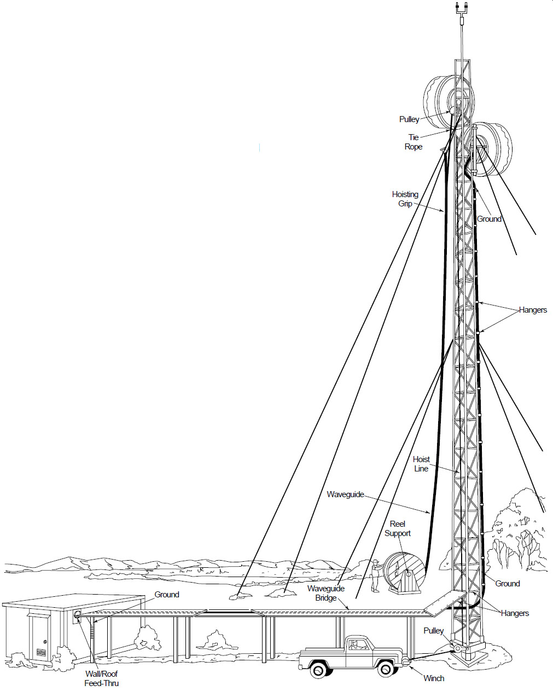
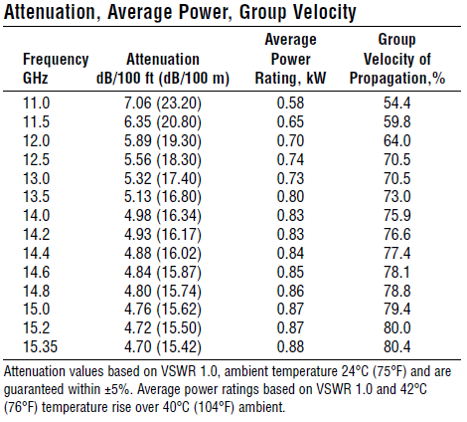
Waveguide Loss

Slide 60
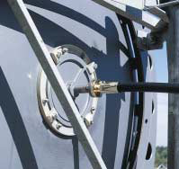
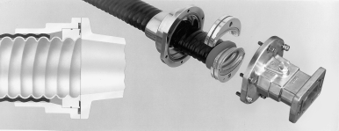
Transmission Losses
COUPLING LOSS
RADOME LOSS
CONNECTOR LOSS
HYBRID LOSS

Slide 61
Fade Margins
Parameter | Function | Value | Unit | Type | Description
Microwave Radio Output Power | Given |  | dB | Variable | Taken from Radio Specification
Connector Loss | Subtracted |  | dB | Typical | Taken from Waveguide Specifications
Waveguide Loss | Subtracted |  | dB | Variable | Taken from Waveguide Specifications
Connector Loss | Subtracted |  | dB | Typical | Taken from Waveguide Specifications
Antenna Gain | Added |  | dB | Variable | Taken from Antenna Specifications
Free Space Loss | Subtracted |  | dB | Variable | Computed from Formula
Antenna Gain | Added |  | dB | Variable | Taken from Antenna Specifications
Connector Loss | Subtracted |  | dB | Typical | Taken from Waveguide Specifications
Waveguide Loss | Subtracted |  | dB | Variable | Taken from Waveguide Specifications
Connector Loss | Subtracted |  | dB | Typical | Taken from Waveguide Specifications
Power Input to Receiver (RSL) | Computed |  | dB | Variable | Computed from Formula
Minimum Receiver Threshold | Given |  | dB | Variable | Taken from Radio Specification
Thermal Fade Margin | Computed |  | dB | Variable | Computed from Formula

Slide 62
Atmospheric Absorption Loss (AAL)
a. OXYGEN ABSORPTION LOSS
- attenuation due to the absorption of radio frequency energy by oxygen molecules in the atmosphere.
b. WATER VAPOR LOSS
- attenuation due to the absorption of radio frequency energy by water vapor in the atmosphere.

Slide 63
Miscellaneous Path Loss (MPL)
a. DIFFRACTION LOSSES
- Defined as the modulation or redistribution of
energy within a wave front when it passes
near the edge of an opaque object.
- path is blocked by an obstruction
i. DLP – Diffraction Loss due to Path
ii. DLS - Diffraction Loss due to Shielding
b. REFLECTION LOSS (RL)

Slide 64
OTHER LOSSES
a. RAIN LOSSES
- attenuation due to the effects of rain
b. CLUTTER LOSSES
- attenuation due to trees and buildings in the front of the antenna
c. ANTENNA MISALIGNMENT
- human factor error. This loss comes from the condition of the antenna when being installed. The value of this loss is assumed never to go above 0.25dB per antenna or 0.5 dB for the link.

Slide 65
NET PATH LOSS
Difference between the transmitter output power and the RSL.

Slide 66
Fading and Fade Margin

Slide 67
Fading
Variations in signal loss which can be caused by natural weather disturbances, such as rainfall, snowfall, fog, hail and extremely cold air over a warm earth.
Can also be caused by man-made disturbances, such as irrigation, or from multiple transmission paths, irregular Earth surfaces, and varying terrains.

Slide 68
Fade Margin
is the difference between the RSL and the receiver threshold or sensitivity.
is the additional loss added to the normal path loss to accommodate the effects of temporary fading, that considers the non-ideal and less predictable characteristics of radio-wave propagation

Slide 69
CATEGORIES OF FADING
FLAT FADING
non-frequency dependent fading occurring during atmospheric variations like heavy rain and ducting and aging or partial failure of equipment.
FREQUENCY SELECTIVE FADING
due to multipaths formed by atmosphere, terrain reflection, and diffraction.

Slide 70
COUNTERMEASURES
FLAT FADING
Link Overbuilding (Antenna,Improved receiver performance,power)
Resite or shorten distance between sites (multihops)
Path Diversity
SELECTIVE FADING
Space Diversity
Frequency Diversity
Equalizers
EQUIPMENT RELIABILITY
Hot –standby Arrangement
Diversity Arrangement

Slide 71
Diversity
Providing separate path to transmit redundant information
Frequency diversity
Uses two different frequencies to transmit the same information.
Space diversity
Same frequency is used, but two receive antennas separated vertically on the same tower receive the information over two different physical paths separated in space.

Slide 72
The method of transmission may be due to:
a. FREQUENCY
b. SPACE (including angle of arrival and
polarization)
c. PATH (signals arrive on geographically
separate paths)
d. TIME (a time delay of two identical signals
on parallel paths)

Slide 73
PATH DIVERSITY
Method of signal rerouting or simultaneous transmission of same information on different paths. Paths should be at least 10 kms apart.

Slide 74
SPACE DIVERSITY
The receiver accepts signals from 2 or more antennas that are vertically spaced apart by many wavelength (200λ or more)
Depending upon the design, the diversity combiner either selects or adds the signal. If signals are to be added, then they should be brought in phase.
The lower of the two antennas must be high enough for reliable LOS communication.

Slide 75
Space Diversity
Transmitter
Receiver

Slide 76
Space Diversity Main Features
No additional frequency assignment is required.
Provides path redundancy but not equipment redundancy.
More expensive than frequency diversity due to additional antennas and waveguides.

Slide 77
SPACE DIVERSITY FORMULA
Antenna Separation Formula
Improvement Factor
where:
S = separation (m)
R = effective earth
radius (m)
λ = wavelength (m)
L = path length (m)
U_{sdp} = Undp
l_{SD}
Where:
l_{SD}= space diversity improvement
factor (Ratio)
S = vertical separation bet 2 antennas (m)
F = frequency (GHz)
D = Path length (m)
FM = fade margin, smaller vase (dB)

Slide 78
FREQUENCY DIVERSITY
modulates 2 different RF carrier frequencies with the same IF intelligence, then transmits both RF signals to a given destination.
the carrier frequencies are 2-3% separated, since the frequency band allocations are limited.

Slide 79
Frequency Diversity
Transmitter
Receiver

Slide 80
Improvement Factor of Frequency Diversity
0.8 D_{f}x 10^{(FM/10)} U_{ndp}
l_{FD} = f²D ; U_{FDP} = l_{FD}
Where:
l_{FD} = improvement factor (ratio)
D_{f} = Frequency Separation (Mhz)
FM = Fade Margin
F = frequency (Ghz); (2≤ f ≤ 11)
D = Path length (km); (30≤ D ≤ 70)

Slide 81
Time Unavailability
Time availability (A_{v}) is commonly in the range from 0.99 to 0.99999 or 99% to 99.999% of the time.
Unavailability (U_{nav})is just contrary to the above definition.

Slide 82
Fade Margin for Rayleigh Fading
Time Availability (%) | Fade Margin (dB)
90 | 8
99 | 18
99.9 | 28
99.99 | 38
99.999 | 48
Example:
A link with a minimum unfaded C/N specified as 20 dB. What will be the C/N requirements to meet the objective of 99.95% time availability? What is the total time in a year when the C/N would be less than 20 dB?

Slide 83
References
Radio System Design for Telecommunication, Third Edition
Roger L. Freeman
Copyright © 2007 John Wiley & Sons, Inc.
Microwave Transmission Networks
Harvey Lehpamer
Copyright © 2004 McGraw-Hill Companies, Inc.
Fundamentals of Microwave Communication
Manny T. Rule
Microwave Engineering Design Consideration
Lenkurt

Slide 84
THANK YOU…

